Slide 1
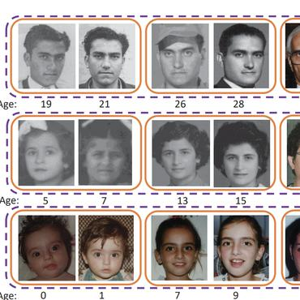
Age estimation
Implementing Dex and Residual Dex methods

Slide 2
Inspired by:
article : DEX (Deep expectation of real and apparent age)
Data set : IMDB-WIKI + LAP,
Architecture : VGG + Expected-value, MAE : 3.25(5.2 w/o pretraining)
article : DEX with deep residual regressors
Data set : Appa-real-release,
Architecture : VGG + Expected-value + residual regressor, MAE : 5.296
- Age estimation project : https://github.com/yu4u/age-estimation-pytorch

Slide 3
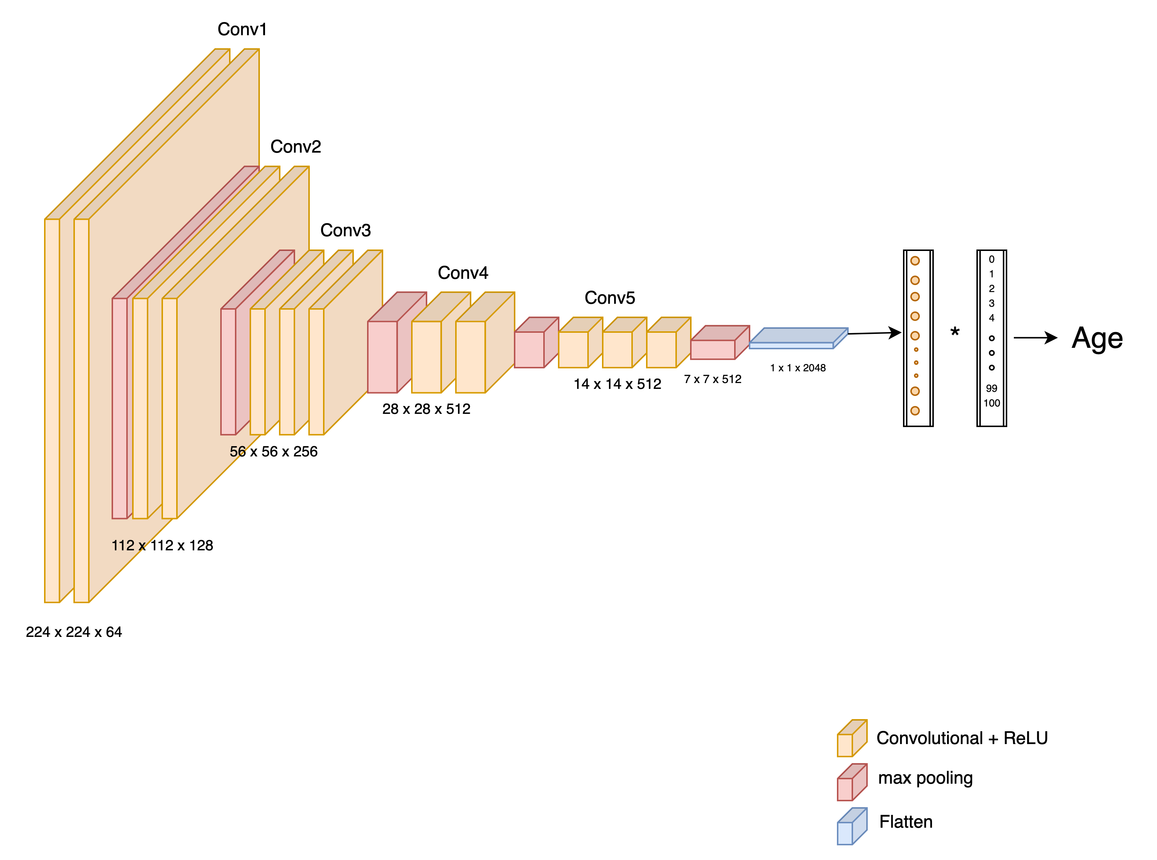
DEX and DEX residual
We limited our work to the prediction of apparent age.
We used the Appa-real dataset for both tasks
Resnet50

Slide 4
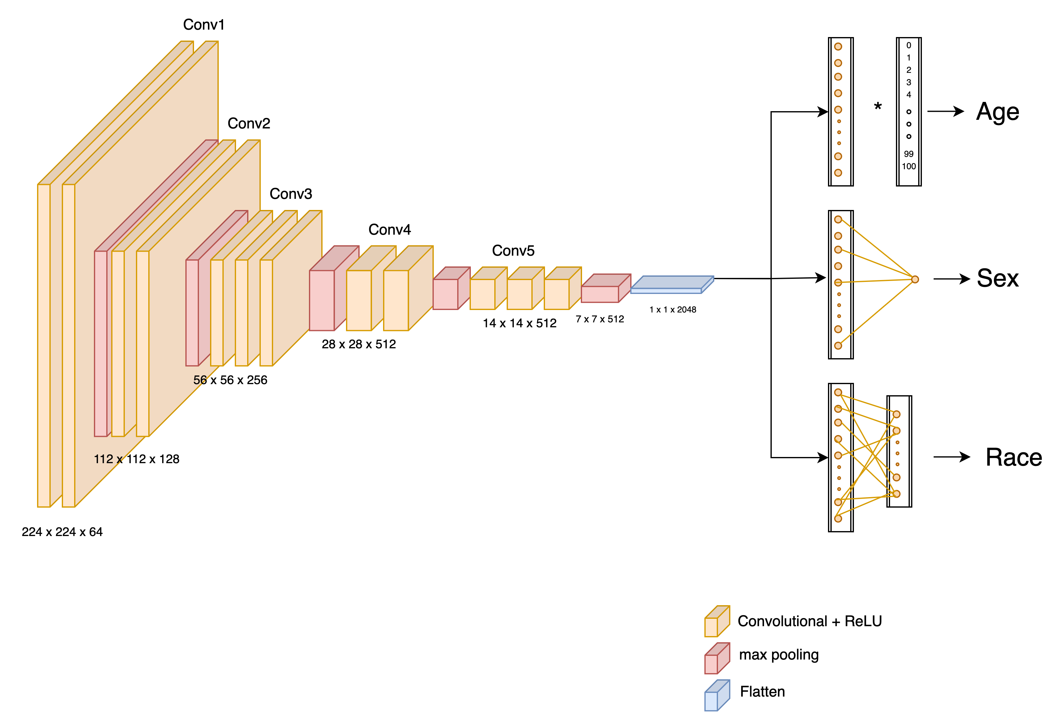

New Model Architecture
-Caucasian
-Afroamerican
-Asian
$$loss= α∙loss_{age}+β∙loss_{sex}+γ∙loss_{race }$$
$| (α$, $β$, $γ ) =(1,1,0.2)$

Slide 5
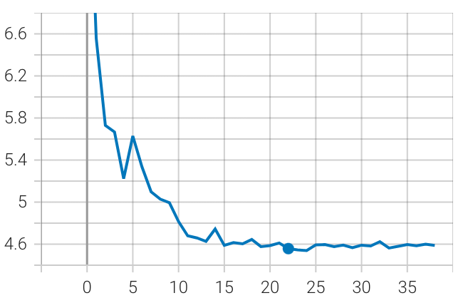
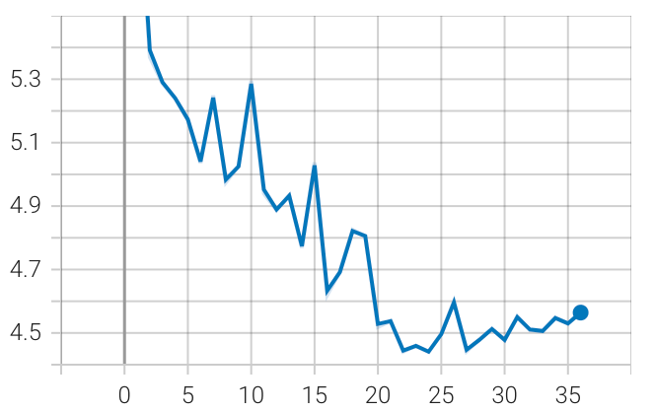
Effect of sex and race on training dynamics
Speed up the training
Less fluctuation
No apparent improvement on final results
DEX + Sex and Race
DEX Basic

Slide 6
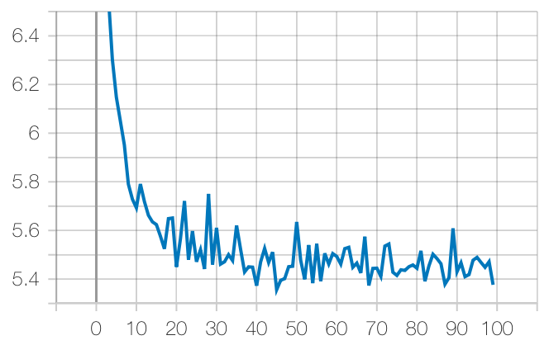
Batch size effect
Smoother losses
Better performance
Small batch size
big batch size
GPU memory limitation for big batch size
(max 40 for 8 gb)
Solution : Overcoming this Constraints using Gradient Accumulation

Slide 7
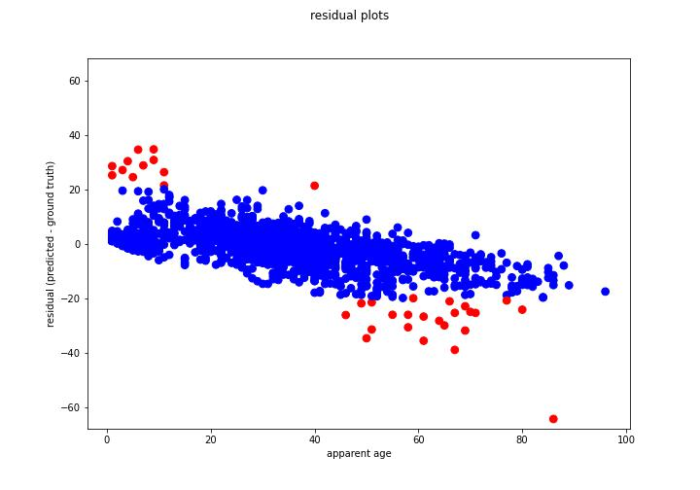
Inspecting residuals

Slide 8
A close look at out layers
The majority of them are due to false cropping or misplaced faces.

Slide 9
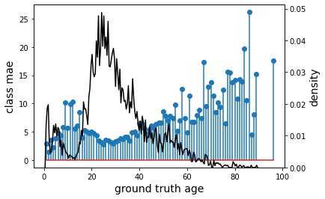
Unbalanced data and effect on accuracy

Slide 10
Best results
Model | MAE-valid | MAE-test
DEX | 3.9 | 4.67
DEX + Sex and Race | 4.2 | 5.1
residual | 4.5 | 5.2
Dex + residual |  | 20.5

